Slide 1


EATING HABITS EATING DISORDERS EFFECTS OF EATING WHITE PRODUCTS.
HEALTH AND LIFESTYLE
Class - 11

Slide 2
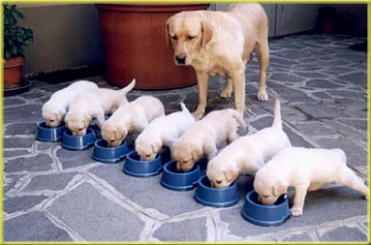
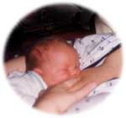

HOW TO DEVELOP HEALTHY EATING HABITS?
‘Feeding oneself and one’s offspring is the first concern of all living creatures’
Notes:
2
Today I will talk to you about good food habits and how we parents play a major role in it. I start with this wounderful slide with the saying “ ”. So it is clear whether it is a human being , animal or birds it is our prime duty to feed our offspring's healthy food .

Slide 3
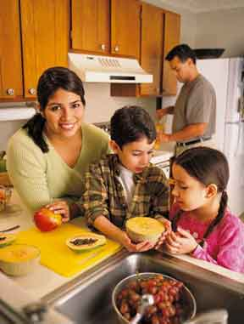
PROMOTE GOOD FOOD HABITS
Like reading and writing, brushing teeth, and hand washing, learning good food habits is a life skill that can help your child live a healthy, satisfying life. Here’s how you can nurture good food habits.
Notes:
Like reading and writing, brushing teeth, and hand washing, learning good, food habits, is a life skill, that
can help your child, live a healthy, satisfying life. Here’s how you can nurture good food habits.
3

Slide 4

Be a good role model.
Your child watches what you eat.
If you eat and enjoy greens, fruits, vegetables, or plantains, chances are, your child will try them too – if not now, then probably later.
It’s not just what you say, it’s also what you do. As kids grow up, a brother, sister, and others in their life are role models, too. Remember most children want to grow up doing what others do.

Slide 5

Give your child enough table time.
Does your child seem to dawdle at the table? That’s normal.
Young children don’t have the muscle development or skills to eat as fast as you.
They still need practice with eating, and utensils.
Eat at a pace that allows you to enjoy your food. It takes about 20 minutes for the stomach to feel full.
Rushing mealtime only leads to frustration for you, your child, and others at the table!

Slide 6
Skip the urge to reward, punish, or appease your child with food.
Have you ever been tempted to say: “If you don’t eat one more bite, I’ll be mad!” “Clean your plate so you can play,” “No dessert until you eat your vegetables,” or “Stop crying, and I’ll give you a cookie”?
Remarks like these may lead kids to eating problems. They may create unneeded conflict and struggles between you and your child at the table.
• Eating for parental approval or love teaches unhealthy behaviors, attitudes, and beliefs about food and themselves.
• Rewarding a clean plate teaches them to ignore body signals, and that may lead to overeating.
• Offering a food (dessert) as a reward for eating another (veggies) makes some foods seem better.
• Getting a food treat to feel better teaches kids to relieve negative feelings by eating. This can lead to overeating later on.

Slide 7
Instead use a non-food approach.
Reward your child with attention and kind words.
Console with hugs and talk. Show love by spending time and having fun together.

Slide 8
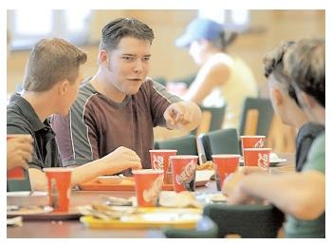

Teenagers have the reputation of having the worst eating habits.
They may skip a meal. Or they may eat fast foods which are generally inadequate in minerals (calcium) and vitamin (vitamin A) but high in calories, saturate fat and sodium.

Slide 9
ADOLESCENTS’ EATING HABITS.
Physical and psychosocial pressures influence adolescents’ eating habits. The boy fares better than the girl in that his large appetite and sheer volume of food leads him to consume adequate nutrients.
But the adolescent girl is less fortunate because
her physiologic sex differences associated with fat deposits during this period and comparative lack of physical activity she may gain weight easily,
social pressures and personal tensions concerning figure control will cause her to follow unwise, self- imposed crash diets for weight loss.
self starvation may result in complex and far reaching eating disorders like anorexia nervosa and bulimia.

Slide 10
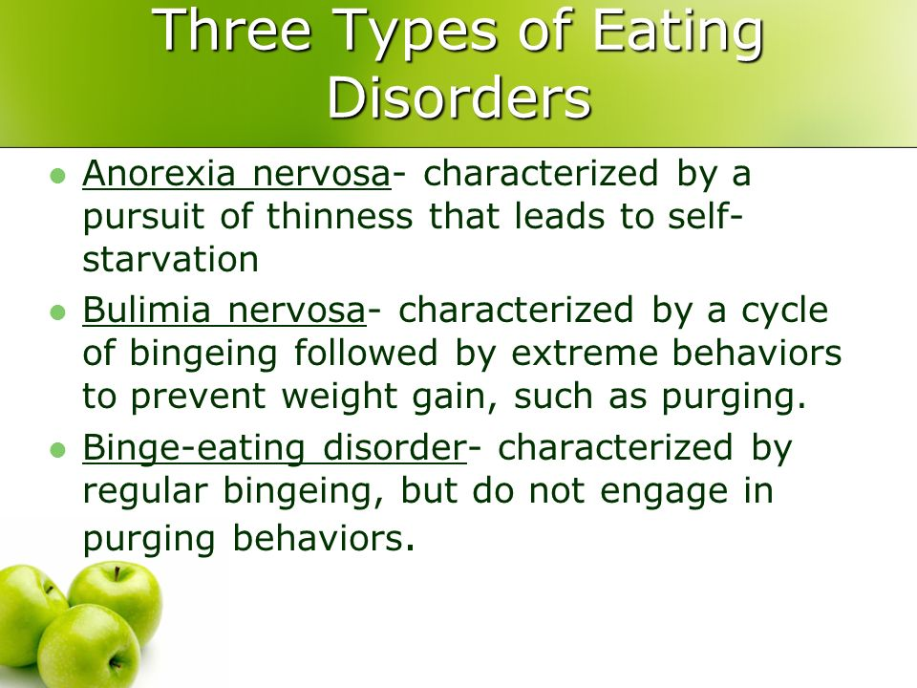

Slide 11
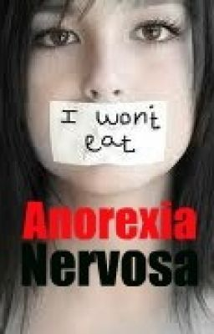
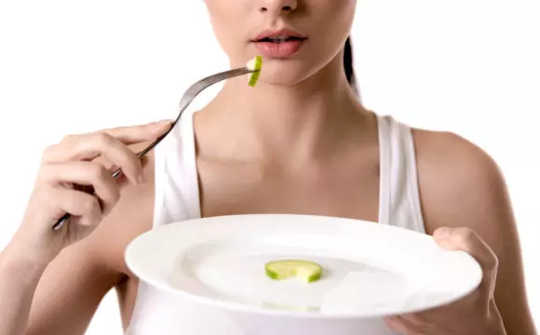
Anorexia nervosa is an eating disorder characterized by immoderate food restriction, inappropriate eating habits or rituals, obsession with having a thin figure, and an irrational fear of weight gain, as well as a distorted body self-perception. It typically involves excessive weight loss and is diagnosed approximately nine times more often in females than in males.^{[1]} Due to their fear of gaining weight, individuals with this disorder restrict the amount of food they consume.

Slide 12
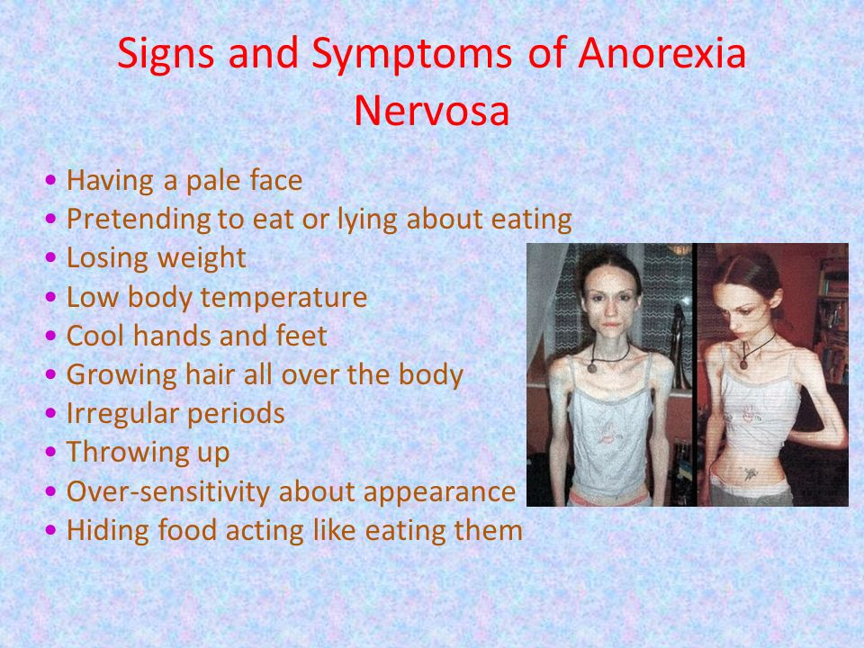

Slide 13
FOOD AND EXERCISE HABITS
Cooking for others or obsessing about food but not eating.
Rigidly avoiding specific foods or whole categories of food (dairy, meats, fats, etc).
Refusing to eat, denying hunger, eating tiny portions of food
Exercising excessively.
Possessing in depth knowledge of calories and fat in foods.
Consuming odd food combinations or large amounts of low-calorie condiments (e.g., mustard, vinegars)
Exhibiting ritualistic eating behaviors, such as cutting foods into tiny bits or using special utensils or plates each time when eating
Avoiding social invitations because of food that might be served

Slide 14
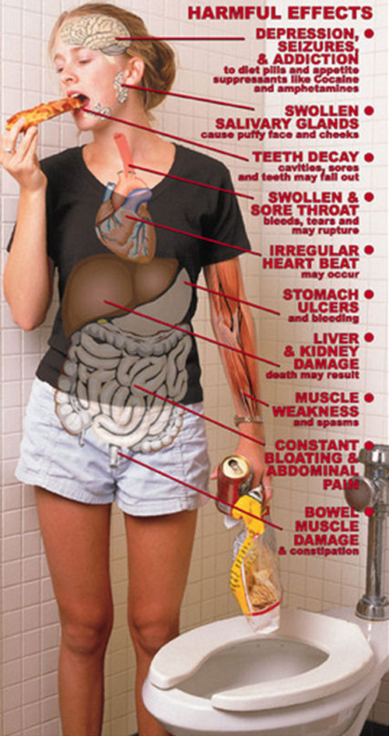
Bulimia nervosa is an eating disorder characterized by binge eating and purging, or consuming a large amount of food in a short amount of time followed by an attempt to rid oneself of the food consumed (purging), typically by vomiting, taking a laxative, diuretic, or stimulant, and/or excessive exercise, because of an extensive concern for body weight.

Slide 15
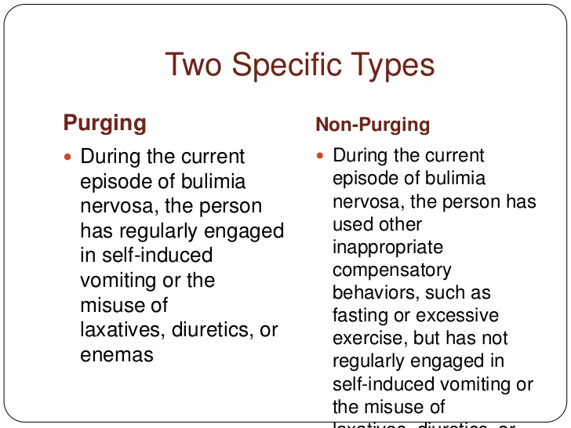

Slide 16
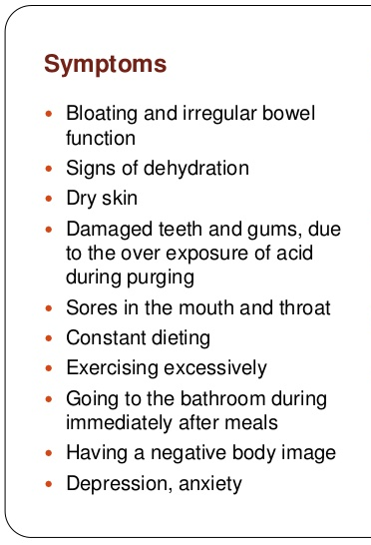
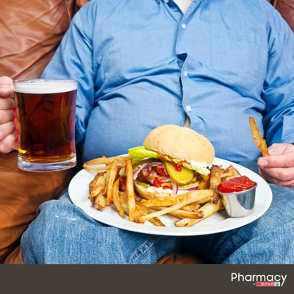

Slide 17
BULIMIA NERVOSA
PHYSICAL SIGNS
Onset in late teens or early twenties, often after weight loss
or dieting attempts
Usually near ideal body weight, but often with weight fluctuations
Eats very large meals, but without gaining weight
Calluses – calcified tissue-on back of hands.
Dental enamel erosion, cavities
Fatigue or weakness due to malnutrition
Irregular menstrual periods

Slide 18
FOOD AND EXERCISE HABITS
Frequent binge eating
Strict dieting followed by bingeing
Leaving room after eating, often to bathroom
Purging via diuretics, laxatives, emetics such as syrup of ipecac, or enemas, over exercising, fasting, or vomiting
Hiding eating from others
Avoiding social invitations because of food that might be served

Slide 19
BINGE EATING DISORDER
PHYSICAL SIGNS
Onset at any age, often not recognized until adulthood
Usually overweight or obese
May have obesity-related diseases, such as type II diabetes,
high blood pressure, high cholesterol

Slide 20
Food and exercise habits
Frequent dieting
Losing and regaining weight (weight cycling) or chronically dieting without losing weight
Frequent binge eating or eating when not hungry
Eating to point of extreme discomfort
Frequently eating large amounts in short time
Hiding eating or eating only small amounts when with others
Avoiding social invitations because of food that might be served
Having difficulty exercising because of excess weight
Trying to avoid physical activity or anything that might call attention to or increase own awareness of one’s body

Slide 21
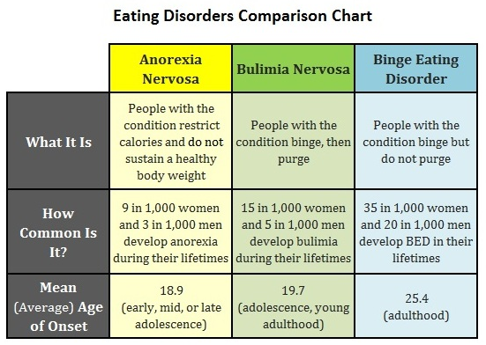

Slide 22
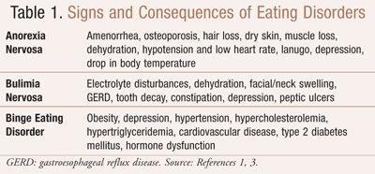

Slide 23
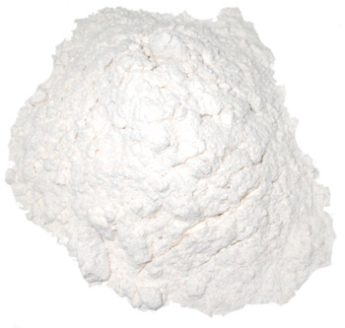
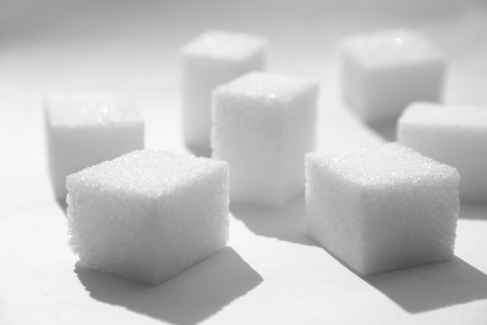
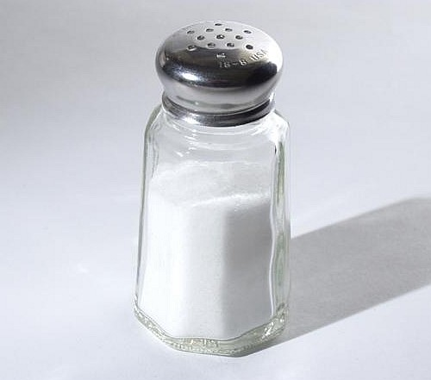
EFFECTS OF EATING WHITE PRODUCTS.
Sugar, salt, milk and maida are white foods that may
actually blacken your health.

Slide 24
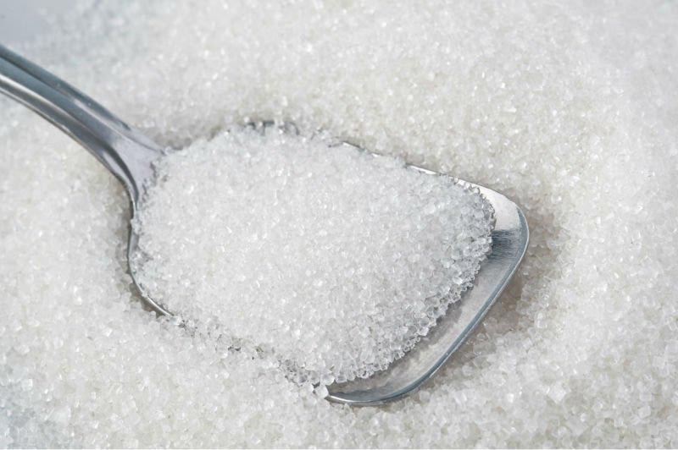
Sugar: Sugar is used as a sweetening agent.
Sugar contains glucose which is simple a sugar (monosaccharide) and provides instant energy to our bodies.
Sugar gets digested and absorbed quickly in our bodies, which increases our blood glucose levels.
This process of instant digestion and absorption of sugar can lead to several health problems.
Several studies had proved sugar can cause lifestyle related disorders such as diabetes, obesity and cardiovascular disorders. Excess sugar gets stored in your body as fat which leads
to obesity and is the primary cause of most lifestyle related diseases. People suffering from diabetes and heart problems can develop hypoglycaemia and hyperglycaemia.
Usage of honey or jaggery instead of sugar is a healthy alternative.

Slide 25
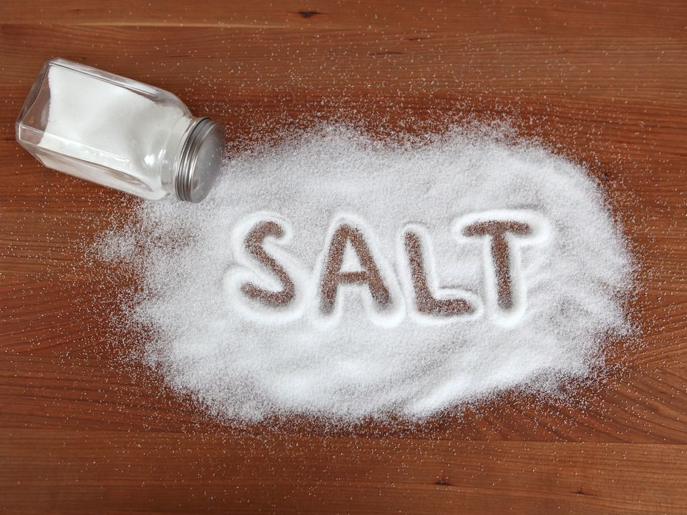
Salt: Table salt is an important ingredient in the Indian diet and while lack of salt can cause osteoporosis,
muscle cramping and goitre, too much of it can be harmful to your health as well. Salt provides sodium
and chloride which is required for maintaining body fluid equilibrium and normal body functioning.
However, if used in excess, it can lead to hypertension and cardiovascular diseases. Excess salt in
your body limits circulation and toxic waste elimination.” Consume 5 to 8gms or less of salt in a day to avoid any adverse effects.

Slide 26
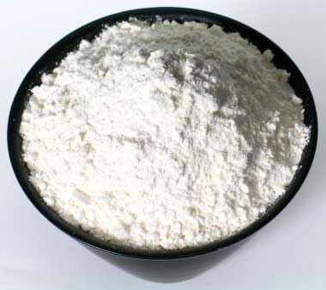
Maida: While milk, salt and sugar are important for our body when consumed in limit, maida, also known as all purpose flour, has no purpose and can be completely eliminated from your diet.
Maida is a waste that gets ejected while processing wheat. When wheat is processed, the fibre, vitamins, husk, proteins and all edible parts are removed and what remains is rava.
This is further bleached to make it white and the chemical alloxan is added to give it a smoothening effect.
Maida contains carbohydrates. These carbs are converted into sugar and when consumed they can cause obesity and diabetes.”Maida should be replaced by whole wheat flour.

Slide 27
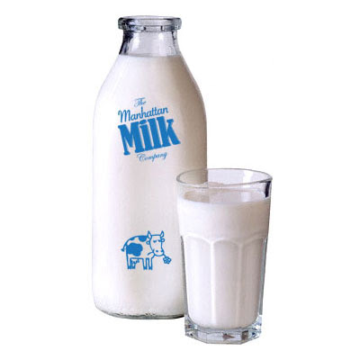
Milk: Milk is another important ingredient needed in our daily lives. We use it every day, either directly or in our tea, coffee or milkshakes. There are several benefits of drinking milk — it provides protein, fat and calcium. It also strengthens bones and teeth and protects you from dehydration.
But, when consumed in excess, milk can lead to an increase in fat levels which results in hypercholresteremia and hyperlipidemia.
Excess consumption can also cause diarrhea, bloating and constipation. Replace whole milk with cow’s milk or skimmed milk.

